Slide 1
Lab 2 – Intro to DS, Distance & Similarity
CS 506

Slide 2
About me

Slide 3
Lab grading
Labs are worth 10% of your grade
Labs are fully attendance based
You can miss up to 3 labs and still get all 10% toward your final grade

Slide 4
Learning Objectives
Understand cosine similarity and Jaccard similarity
Understand properties of Minkowski distance with varying p
Implement cosine similarity, Jaccard similarity, and Minkowski distance in Python
Identify when to use Jaccard similarity vs. L1-norm
Identify when to use cosine similarity vs. L2-norm

Slide 5
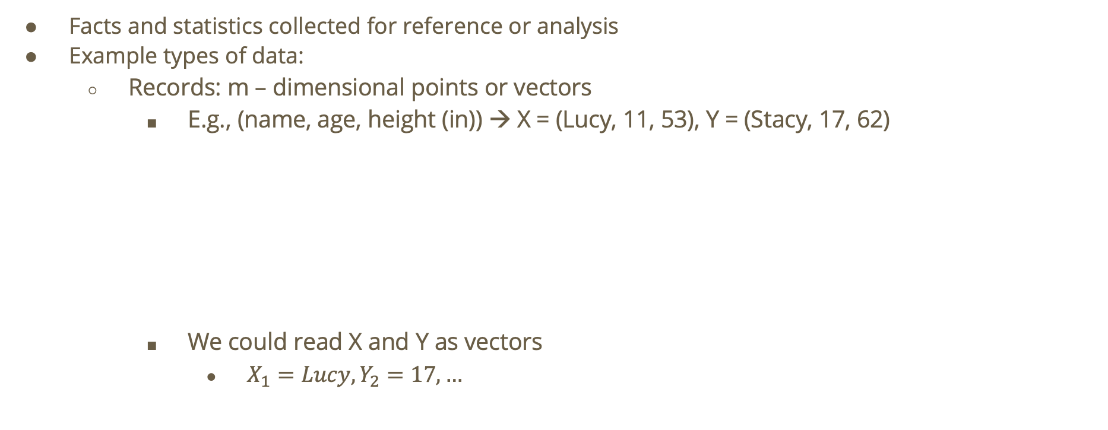
Data
Facts and statistics collected for reference or analysis
Example types of data:
  Records: m – dimensional points or vectors
    E.g., (name, age, height (in)) → X = (Lucy, 11, 53), Y = (Stacy, 17, 62)
    We could read X and Y as vectors
      $X_{1}=Lucy,Y_{2}=17,…$
Height
Stacy
Lucy
Age

Slide 6
Data (cont.)
Example types of data:
  Graphs: nodes connected by edges
  E.g., graph to show a social media network. Nodes = individual people, Edges = follower relation
Joe
Jill
Jared
Jack

Slide 7

Data (cont.)
Example types of data:
  Graphs: nodes connected by edges
  E.g., graph to show a social media network. Nodes = individual people, Edges = follower relation
  Adjacency Matrix: $\left(\begin{matrix}0 & 1 & 0 & 0 \\ 0 & 0 & 1 & 0 \\ 0 & 0 & 0 & 1 \\ 1 & 0 & 1 & 0\end{matrix}\right)$
Looks like Joe and Jared follow each other!
Joe
Jill
Jared
Jack
Jill
Joe
Jack
Jared
Jack
Jill
Joe
Jared

Slide 8
Other types of data
Images
  E.g., a matrix of pixels
Text
  E.g., list of words
Corpus of documents

Slide 9
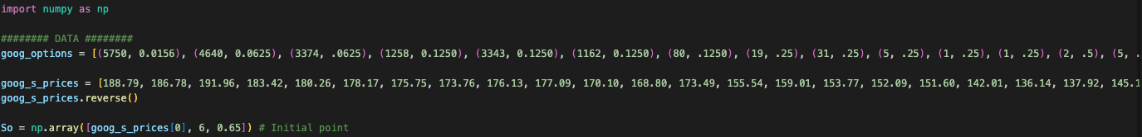
How can we represent vectors and matrices when programming?
NumPy provides fast, memory-efficient data structures and math operations for working with arrays, vectors, and matrices.
  NumPy is compiled in C!
  We can do vectorized math in NumPy as opposed to Python itself which would require us to use loops.
  NumPy includes linear algebra functionality, statistics, and serves as the foundation for any sort of math we do in Python
    E.g. image processing, machine learning, etc.

Slide 10
Recall: Learning
Learning: algorithms are trained on data (e.g., Facebook user behavior) to learn general rules or patterns, allowing them to predict future outcomes (e.g., what ads will the user most likely be interested in) or classify new data.
Supervised vs. Unsupervised Learning
  Unsupervised Learning
    Finding patterns in potentially unlabeled data
    Goals:
      find interesting structure in the data. For example, clustering algorithms!
      Better understand/describe the data (possibly through data exploration and visualization)
      Extract features
      Fill gaps in data
      Make learning algorithms faster
        Get rid of noise!
  Supervised learning
    Learning from labeled data (e.g. our social media network assuming each profile has more dimensions)
    Examples include regression, classification, support vector machines, decision trees, etc.
      We could use classification to predict whether an email is spam! We could use regression for weather forecasting

Slide 11
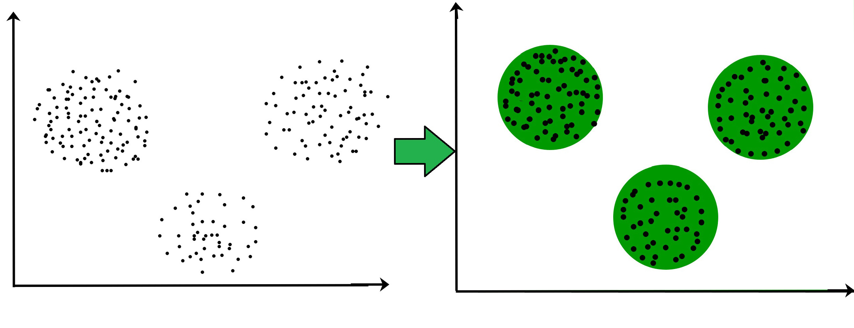
Clustering
Before clustering
After clustering
Question: at a high level, how are points grouped together?

Slide 12
Dissimilarity
Dissimilarity function takes two objects as input and returns a high value if those objects are dissimilar.
dsim(a,b) is “small” dsim(a,b) is “large”
A
A
B
B

Slide 13




Distance Functions
A type of dissimilarity function is a distance function
d is a distance function i.f.f.
  $d\left(i,j\right)=0⟺i=j$
  $d\left(i,j\right)=d\left(j,i\right)$
  $d\left(i,j\right)≤d\left(i,k\right)+d\left(k,j\right)$ (triangle inequality)
  e.g.
Euclidean distance: $d\left(i,j\right)=\sqrt{2}≤1+1$
$$j(1,1)$$
$$k(0,1)$$
$$i(0,0)$$

Slide 14

Minkowski Distance
$∀x,y∈ℝ^{d}$,
$$L_{p}\left(x,y\right)={\left(\sum_{i=1}^{d}{{\left|x_{i}–y_{i}\right|}^{p}}\right)}^{\frac{1}{p}}$$

Slide 15
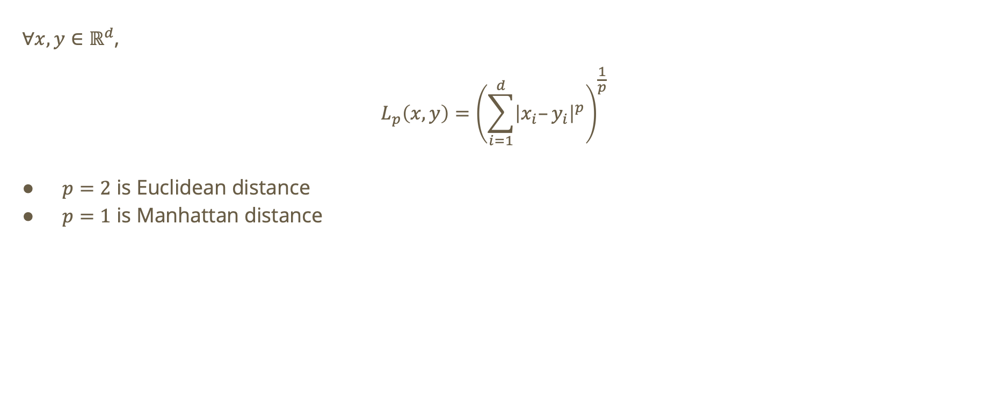
Minkowski Distance
$∀x,y∈ℝ^{d}$,
$$L_{p}\left(x,y\right)={\left(\sum_{i=1}^{d}{{\left|x_{i}–y_{i}\right|}^{p}}\right)}^{\frac{1}{p}}$$
$p=2$ is Euclidean distance
$p=1$ is Manhattan distance

Slide 16

Minkowski Distance using NumPy

Slide 17



Do not edit
How to change the design
What is the Euclidean Distance between i and j?
The Slido app must be installed on every computer you’re presenting from

Slide 18





Euclidean Distance
Using formula…
$$i=\left(0,0\right),j=\left(1,1\right)$$
$$L_{2}\left(i,j\right)={\left(\sum_{i=1}^{2}{{\left|i_{i}–j_{i}\right|}^{2}}\right)}^{\frac{1}{2}}$$
$$=\sqrt{\left({\left(0−1\right)}^{2}+{\left(0−1\right)}^{2}\right)}=\sqrt{2}$$
$$j(1,1)$$
1
$$k(0,1)$$
1
$$\sqrt{2}$$
$$i(0,0)$$

Slide 19
Do not edit
How to change the design
What is the manhattan distance between i and j?
The Slido app must be installed on every computer you’re presenting from

Slide 20




Manhattan Distance
Using formula…
$$i=\left(0,0\right),j=\left(1,1\right)$$
$$L_{1}\left(i,j\right)={\left(\sum_{i=1}^{2}{{\left|i_{i}–j_{i}\right|}^{1}}\right)}^{\frac{1}{1}}$$
$$=\left|0−1\right|+\left|0−1\right|=2$$
$$j(1,1)$$
1
$$k(0,1)$$
1
$$i(0,0)$$

Slide 21
Minkowski Distance for p = 1 vs. p = 2
p=1
  Path length such that you can only move along axes
p=2
  Straight-line displacement from one point to the other

Slide 22

Varying p
As p increases, the distance will become dominated by the largest coordinate difference
Distance becomes sensitive to largest deviation
What happens when $0<p<1$?
  We can prove a violation of the triangle inequality property of distance functions
  No longer a distance function!

Slide 23
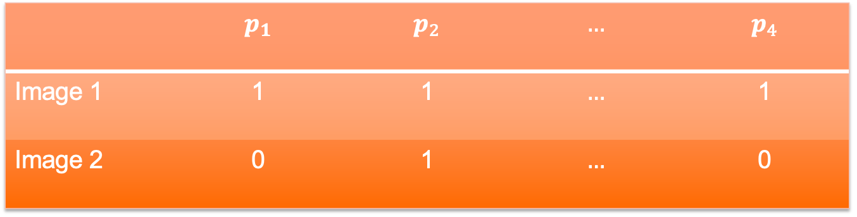
Similarity
How similar are the following images?
 | $$p_{1}$$ | $$p_{2}$$ | $$…$$ | $$p_{4}$$
Image 1 | 1 | 1 | $$…$$ | 1
Image 2 | 0 | 1 | $$…$$ | 0

Slide 24
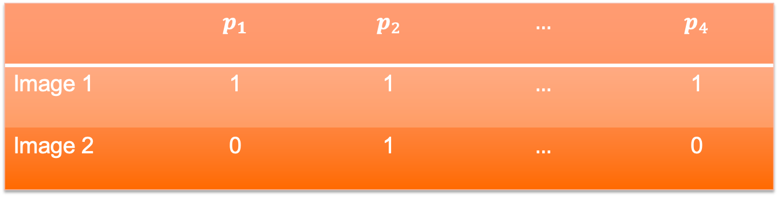

Jaccard Similarity
$JSim\left(x,y\right)=\frac{\left|x∩y\right|}{\left|x∪y\right|}=\frac{\text{total}\text{ \# }\text{matching}}{\text{total}\text{ \# }\text{pixels}}$
Jaccard similarity tells us how similar the data points are. Jaccard distance will tell us how dissimilar they are:
  $JDist\left(x,y\right)=1–JSim\left(x,y\right)$
 | $$p_{1}$$ | $$p_{2}$$ | $$…$$ | $$p_{4}$$
Image 1 | 1 | 1 | $$…$$ | 1
Image 2 | 0 | 1 | $$…$$ | 0

Slide 25
Do not edit
How to change the design
What is the Jaccard Similarity between image 1 and image 2?
The Slido app must be installed on every computer you’re presenting from

Slide 26
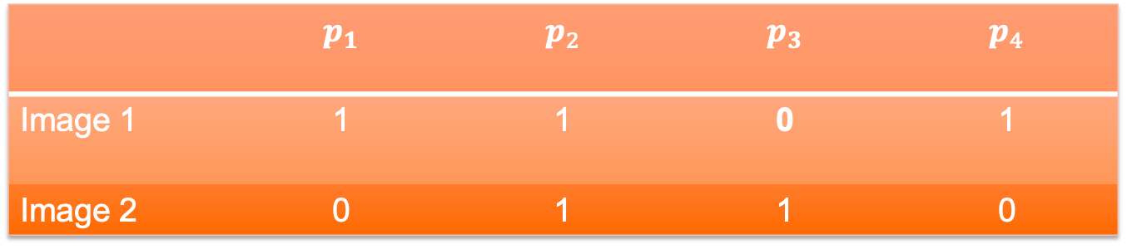

Jaccard Similarity (cont.)
$$JSim\left(Image_{1},Image_{2}\right)=\frac{1}{4}$$
$$JDist\left(Image_{1},Image_{2}\right)=\frac{3}{4}$$
 | $$p_{1}$$ | $$p_{2}$$ | $$p_{3}$$ | $$p_{4}$$
Image 1 | 1 | 1 | 0 | 1
Image 2 | 0 | 1 | 1 | 0

Slide 27
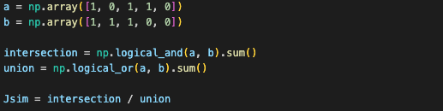
Jaccard Similarity using NumPy

Slide 28

Cosine Similarity
Similarity function takes two objects and returns a large value if the objects are similar
  $s\left(x,y\right) = cos\left(θ\right)$ where $θ$ is the angle between x and y

Slide 29

Cosine Similarity
Similarity function takes two objects and returns a large value if the objects are similar
  $s\left(x,y\right) = cos\left(θ\right)$ where $θ$ is the angle between x and y
  If we have two proportional vectors: $s\left(x,y\right)=cos\left(0\right)=1$

Slide 30

Cosine Similarity
Similarity function takes two objects and returns a large value if the objects are similar
  $s\left(x,y\right) = cos\left(θ\right)$ where $θ$ is the angle between x and y
  If we have two proportional vectors: $s\left(x,y\right)=cos\left(0\right)=1$
  If we have two orthogonal vectors: $s\left(x,y\right)=cos\left(\frac{π}{2}\right)=0$

Slide 31

Cosine Similarity
Similarity function takes two objects and returns a large value if the objects are similar
  $s\left(x,y\right) = cos\left(θ\right)$ where $θ$ is the angle between x and y
  If we have two proportional vectors: $s\left(x,y\right)=cos\left(0\right)=1$
  If we have two orthogonal vectors: $s\left(x,y\right)=cos\left(\frac{π}{2}\right)=0$
  If we have two opposite vectors: $s(x,y) = cos(π) = −1$

Slide 32

Cosine Similarity
Similarity function takes two objects and returns a large value if the objects are similar
  $s\left(x,y\right) = cos\left(θ\right)$ where $θ$ is the angle between x and y
  If we have two proportional vectors: $s\left(x,y\right)=cos\left(0\right)=1$
  If we have two orthogonal vectors: $s\left(x,y\right)=cos\left(\frac{π}{2}\right)=0$
  If we have two opposite vectors: $s(x,y) = cos(π) = −1$
To get a corresponding dissimilarity function, we can try the following:

Slide 33
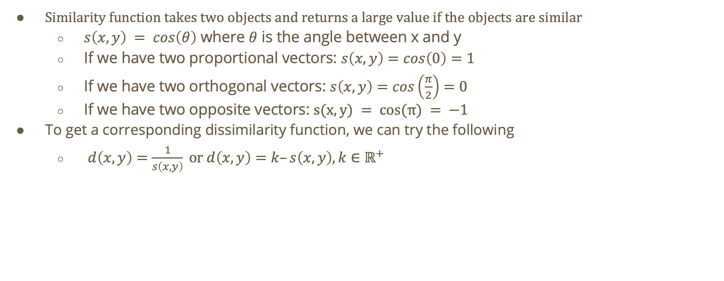
Cosine Similarity
Similarity function takes two objects and returns a large value if the objects are similar
  $s\left(x,y\right) = cos\left(θ\right)$ where $θ$ is the angle between x and y
  If we have two proportional vectors: $s\left(x,y\right)=cos\left(0\right)=1$
  If we have two orthogonal vectors: $s\left(x,y\right)=cos\left(\frac{π}{2}\right)=0$
  If we have two opposite vectors: $s(x,y) = cos(π) = −1$
To get a corresponding dissimilarity function, we can try the following
  $d\left(x,y\right)=\frac{1}{s\left(x,y\right)} \text{or} d\left(x,y\right)=k–s\left(x,y\right),k∈ℝ^{+}$

Slide 34
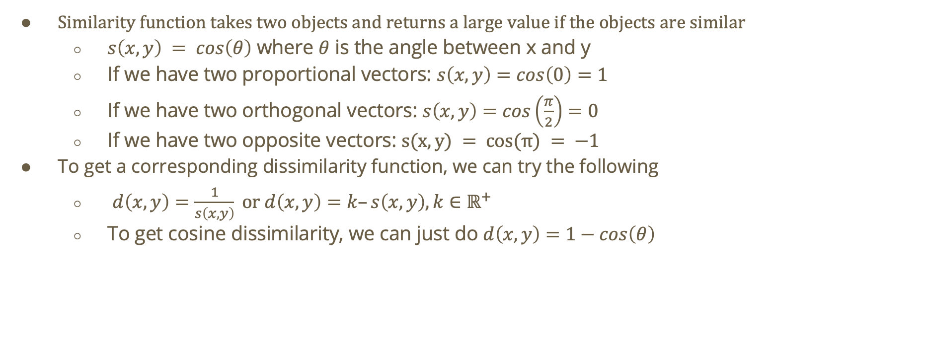
Cosine Similarity
Similarity function takes two objects and returns a large value if the objects are similar
  $s\left(x,y\right) = cos\left(θ\right)$ where $θ$ is the angle between x and y
  If we have two proportional vectors: $s\left(x,y\right)=cos\left(0\right)=1$
  If we have two orthogonal vectors: $s\left(x,y\right)=cos\left(\frac{π}{2}\right)=0$
  If we have two opposite vectors: $s(x,y) = cos(π) = −1$
To get a corresponding dissimilarity function, we can try the following
  $d\left(x,y\right)=\frac{1}{s\left(x,y\right)} \text{or} d\left(x,y\right)=k–s\left(x,y\right),k∈ℝ^{+}$
  To get cosine dissimilarity, we can just do $d\left(x,y\right)=1−cos\left(θ\right)$

Slide 35
Do not edit
How to change the design
What is the cosine similarity between A and B?
The Slido app must be installed on every computer you’re presenting from

Slide 36

What is the cosine and Euclidean distance between the following vectors?
Hint: $cos\left(θ\right)=\frac{A⋅B}{\left|A\right|\left|B\right|}$
Based on the results, what does each distance function prioritize?
Cosine distance prioritizes differences in direction
Euclidean distance prioritizes differences in magnitude
A(1,1)
A(1,1)
B(0,1)
B(0,0)

Slide 37
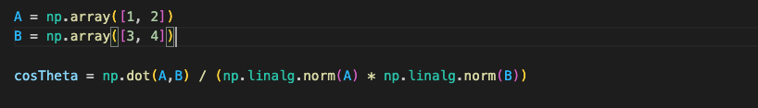
Cosine Similarity and distance using NumPy

Slide 38
Worksheet
Navigate to your lab section’s Discord and complete the worksheet for today’s lab.

